Slide 1

Final Capstone Project
HR Analytics
Notes:
Welcome everyone, my name is Adrian, and this is my Lighthouse Labs project on HR Analytics. What inspired me to do this project is that my wife is in HR and she has been working there for almost 15 years. We did a little roleplay. I asked her if I have some information about employees in an organization, what questions would she have? And she had so many questions… spoke passionately about them. One of the things she mentioned was “employee attrition”.
So what is employee attrition?

Slide 2

What is Employee Attrition?
Employee Attrition
The reduction of employees in a company whether voluntary or involuntary.
Voluntary:
Salary
Career Opportunities
Retirement
Health
Involuntary:
Layoffs
Terminations
Consequently…
Costly to recruit and onboard new employees
Time-consuming to train and replace staff with skills and experience
In Human Resources, it is an important metric to maintain a healthy workforce in the company and continue to bring in new talent and innovations to make a successful company.
Notes:
It means that there is a reduction of employees in a company. It can be voluntary or involuntary. Voluntary means that the employee chooses to leave, whether for higher salary or greater career opportunities, or any other personal reasons, such as retirement or health. Involuntary means that the employer decides to reduce the workforce whether by layoffs or terminations.
Initially, I said to my wife: “This topic seems ordinary… people quit their jobs all the time!” This is where her expertise kicks in saying it is an important metric in HR to keep a healthy workforce cycle. You want to retain your most productive staff and top talents, as well as adding new hires with fresh and innovative ideas to continue to run a successful company. Otherwise, attrition costs time and money to recruit and onboard staff; and train them on their jobs to replace the lost skills and experiences from employee resignations.

Slide 3

The Data
Healthcare / Pharmaceutical Company (Fictional!)
1,480 Employees with 3 Departments
Human Resources
Research & Development
Sales
Goal: Find trends and patterns of attrition between each department.
Notes:
For this project, I obtained a dataset from a fictional healthcare or pharmaceutical company. It has over a thousand employees with 3 main departments – Human Resources that manages employees and the company culture; Research & Development that experiments and creates products for use; and sales that promotes and sells the company’s products to their customers. I wanted to find out any trends or patterns of attrition within each of those departments and think about reasons and solutions to employee departures.

Slide 4
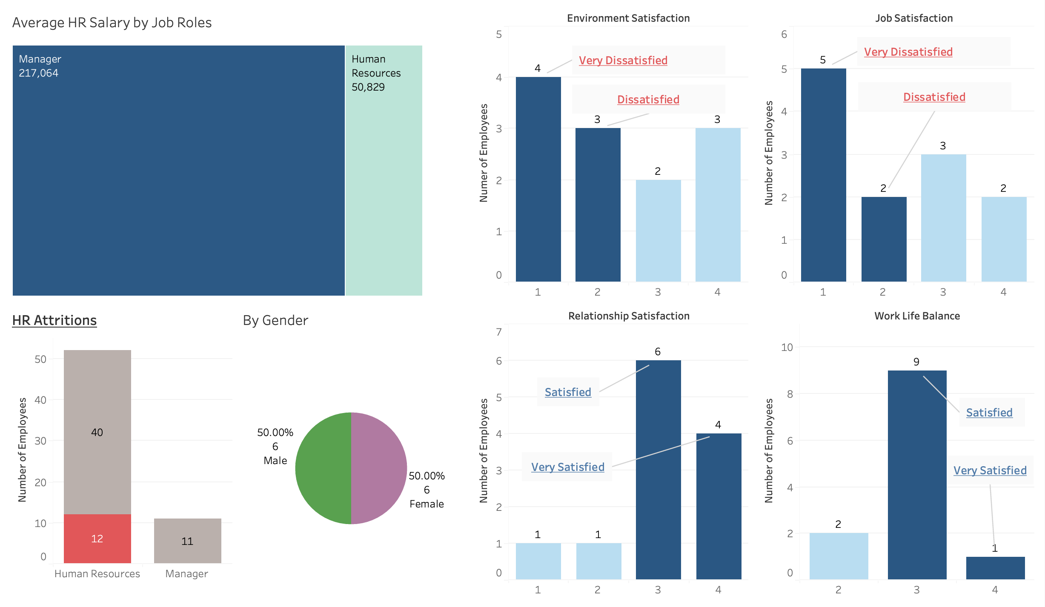
Human Resources
7 out of 12 attritions scored environment and job satisfaction as dissatisfied or very dissatisfied.
10 out of 12 attritions scored relationship and work life balance as satisfied or very satisfied.
Why is there a contrast between different areas of satisfaction scores?
Get comments, feedback, and reviews to put context to the numbers as to why HR employees gave low scores on their environment and job satisfactions.
Are they not happy about salary or are there other motivators that they are not happy about other aspects of their job?
Notes:
Starting with HR, there were 12 attritions. 7 of which were correlated with negative satisfaction scores with the environment and their jobs. Conversely, 10 of them gave relationships and work-life balance positive satisfaction scores. So, there were areas that these employees were happy about and there were other areas that employees felt that need to improve. I think comments, reviews, and feedback – a “pulse check” - my wife likes to say in her job – to give context to the numbers as to why the scores on job environment and job satisfaction are low? Is it because of salary or are there any issues in their jobs that they felt that they are not happy with?

Slide 5
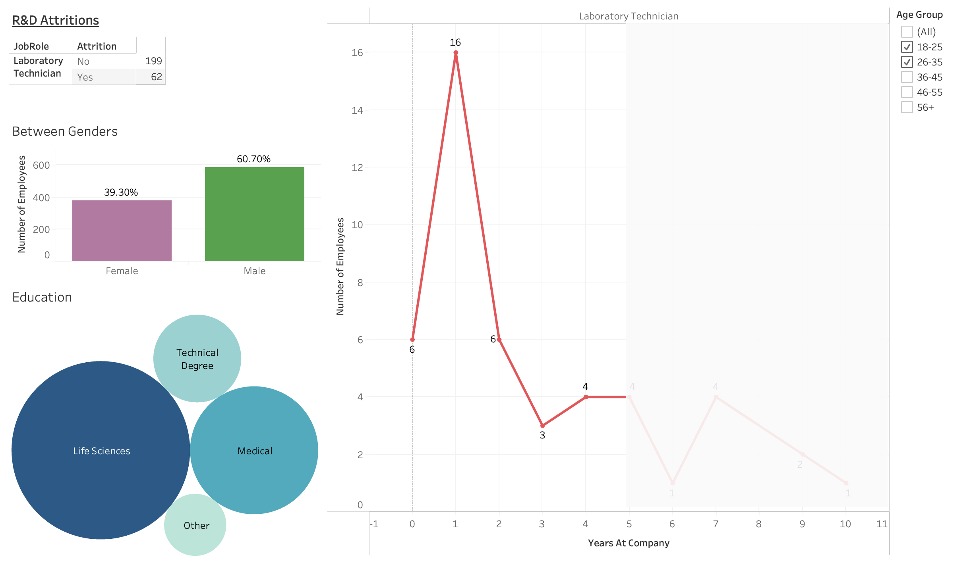
Research & Development
More than a quarter of Lab Technicians quit within the first year of the job.
These employees are young and well-educated aged 35 years or younger.
The job role is considered entry-level in their department.
Why are they so abrupt to quit?
Need to assess the “fit” with the job and company culture.
Clear up misconceptions about the job and duties before hiring.
What is the motivator? Are they eager for a quick career advancement?
Notes:
Next with R&D, over a quarter of Lab Technicians left the company within the first year after being hired. These jobs were mostly entry-level positions, and it was interesting to note that these employees were young and well-educated mostly 35 years or younger. Why were they so abrupt to quit? Those who stayed after a year, you would see that the attrition line dropped. There may need to be an assessment on the “fit if they align with the job and the company culture, as well as clearing up any misconceptions about the job position and responsibilities before they are hired – is this job a “fast-track” to their career trajectory and were they not willing to stick around if they are not presented with the opportunities immediately?

Slide 6
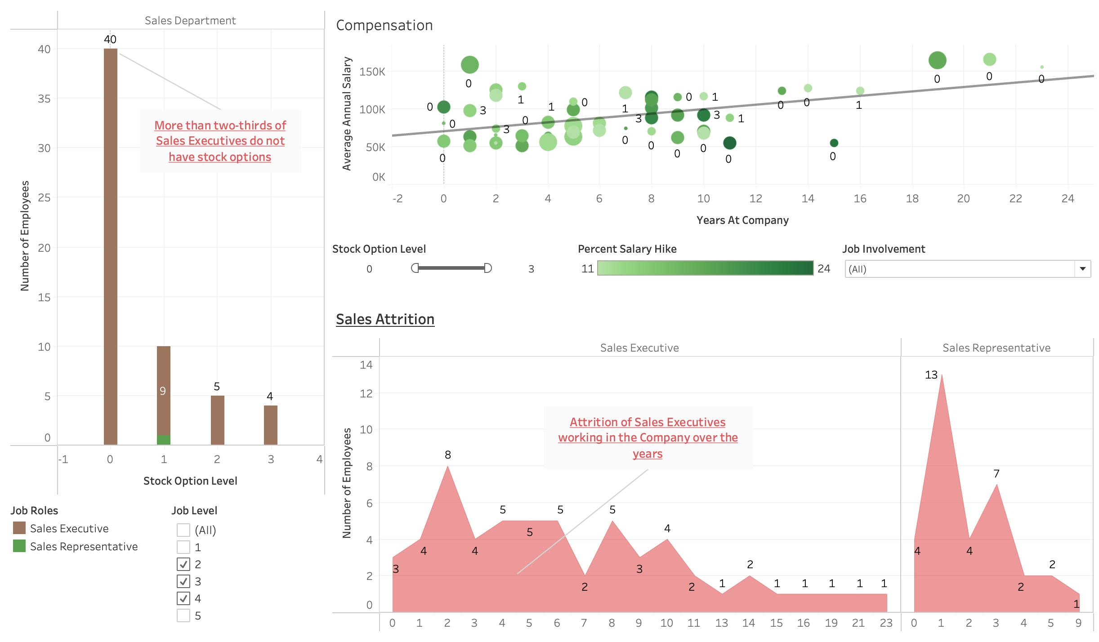
Sales
More than two-thirds of Sales Executives have no stock options.
These employees are considered well-compensated in base salary.
High performance, high productivity, and high engagement. Mid-level job positions crucial in producing revenue.
These employees have wealth of experience. Why are they leaving?
Evaluate the salary compensation package overall. Do they also want recognition aligned with the company’s financial growth and success?
How will this affect the sales department with respect to operations, continuity, and morale?
Notes:
Lastly in Sales, I noticed a frequency of attritions span over a long length of time with Sales Executives. They are well-compensated given their salaries and salary increase for their high level of performance and engagement, but I noticed that two thirds of them do not have any stock options with the company. I find that odd because they are mid-tier jobs, and they need high level of skill and experience as they are important in generating revenue for the company. I am curious to figure out why experienced Sales staff are leaving – is it the overall compensation package not complete or not as competitive as other companies, or do they value the recognition as their successes are the company’s successes financially. And this could be an issue losing the more experience people affecting the department’s operations and bottom-line.

Slide 7

What did I learn?
There is no one-size-fits-all model.
Not just one, but multiple motivators to leave a company.
Employees tend to leave faster than they are hired.
My background is in insurance. I left my previous employer to attend this data analytics bootcamp for a career change!
It was a fun collaboration between data analytics and HR!
Future Goal: Talk to a HR professional about their strategies and how data can help.
Notes:
To conclude, there is no one-size-fits-all model to deal with employee attrition. Not just one, but multiple reasons to leave a company as you all could relate at a point in time. I find that employees leave faster than companies hire, and a lot of times it is out of the company’s control when they make personal decisions to leave. Take myself as an example – I left my previous job and career to do this data analytics bootcamp for a career change.
All in all, it was a fun collaboration between data analytics and HR. My wife is not in attendance, but I hope to have future discussions not just with her, but other HR professionals in different industries on how data can help with their expectations and strategies with employee attrition.

Slide 8

Notes:
Thank you, I hope you enjoyed my presentation.

